Slide 1
Irrigation Prediction
Adrien Chabert
Bachelor Project - UNIGE
1

Slide 2





Bachelor Project - UNIGE
1

Slide 3


200’000 km³ of fresh water
Bachelor Project - UNIGE
1
Notes:
200’000 km3 of fresh water on earth
2/3 for irrigation
Decrease water consumption of 20%-25%
1

Slide 4
Research of Literature
Collect Data
Integration of Machine Learning Algorithm
Test our result
Create a watering plan
Bachelor Project - UNIGE
1

Slide 5
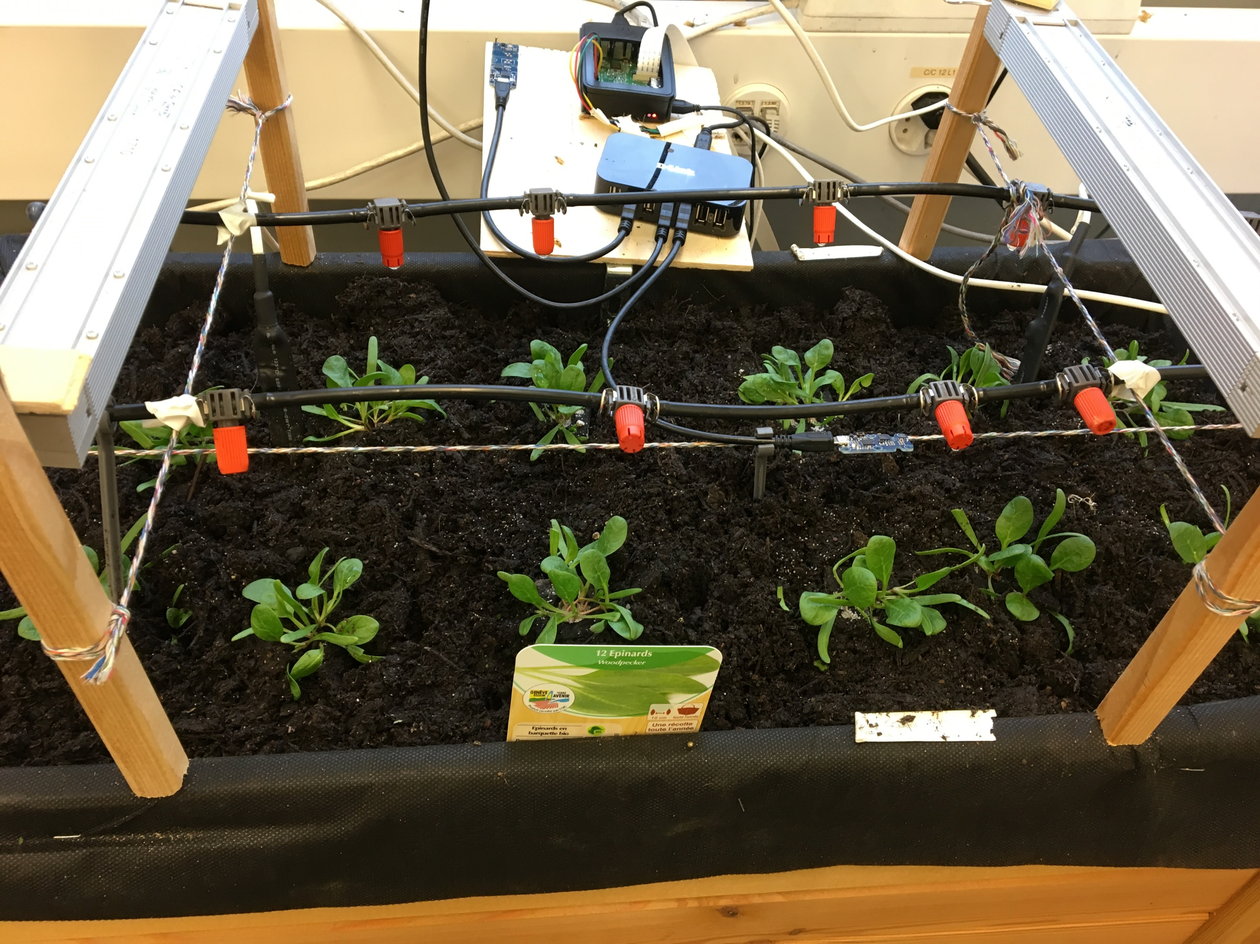
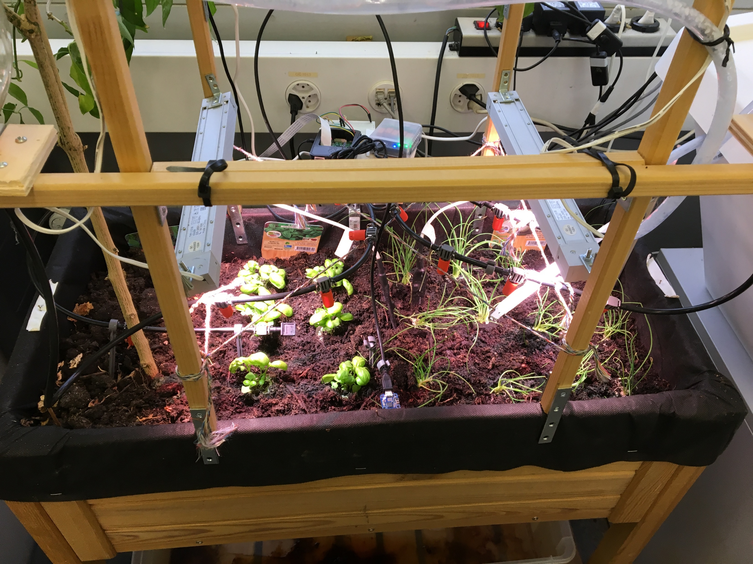
Planting
Basilic, onion, spinach
Bachelor Project - UNIGE
1

Slide 6
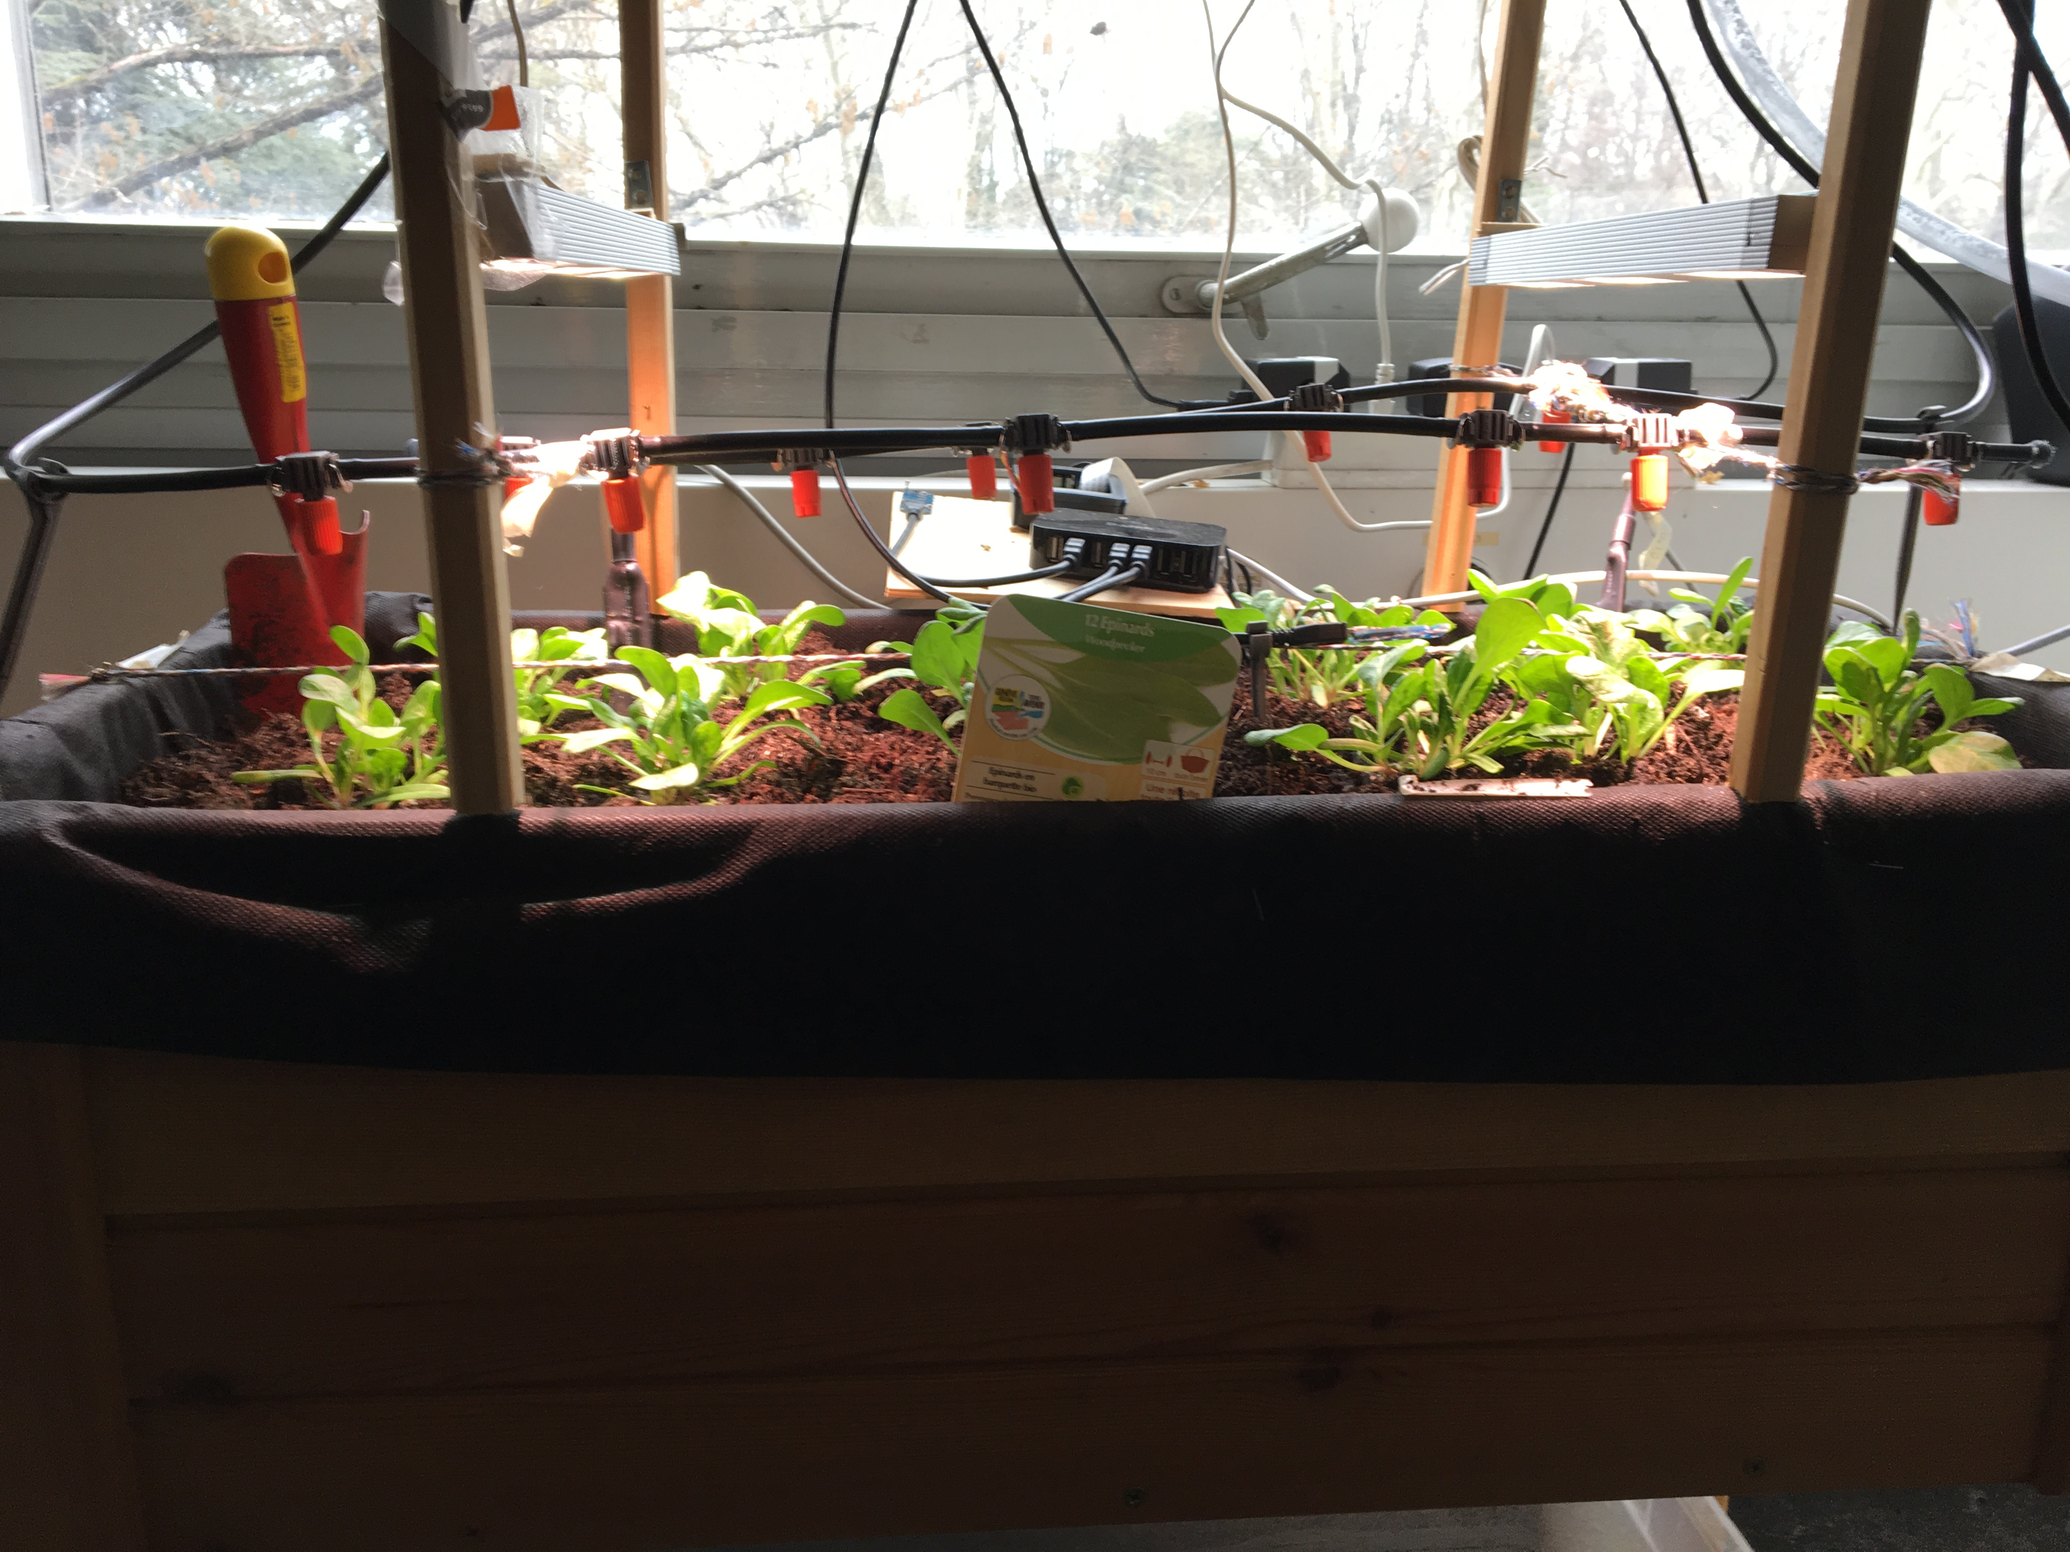
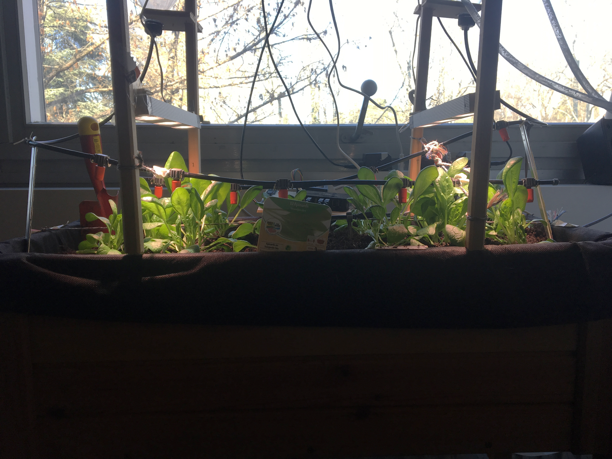
13 mars
20 mars
Bachelor Project - UNIGE
1

Slide 7




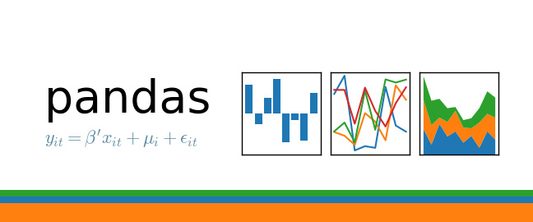
Bachelor Project - UNIGE
1

Slide 8
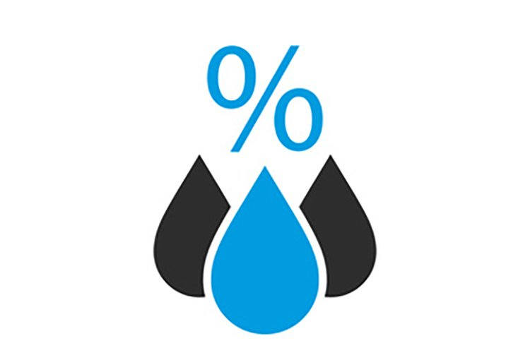
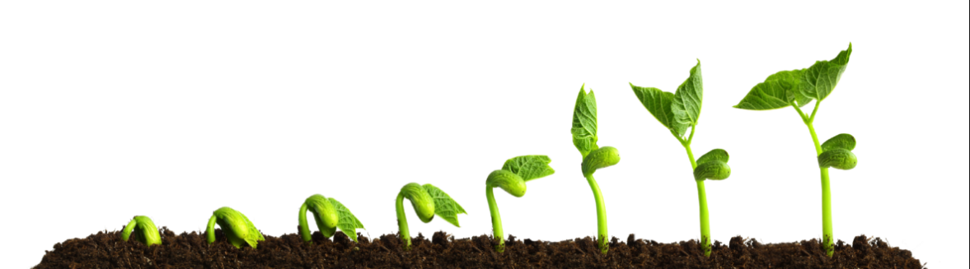


Bachelor Project - UNIGE
1
Notes:
Le vent impacte également mais pas dans notre cas
1

Slide 9
Problems from last meeting
Position of the humidity sensor
Defective Captor
Pandas and Matplotlib not working on Jupyter
Difficulty to implement ML
Lack of knowledge of ML
1

Slide 10
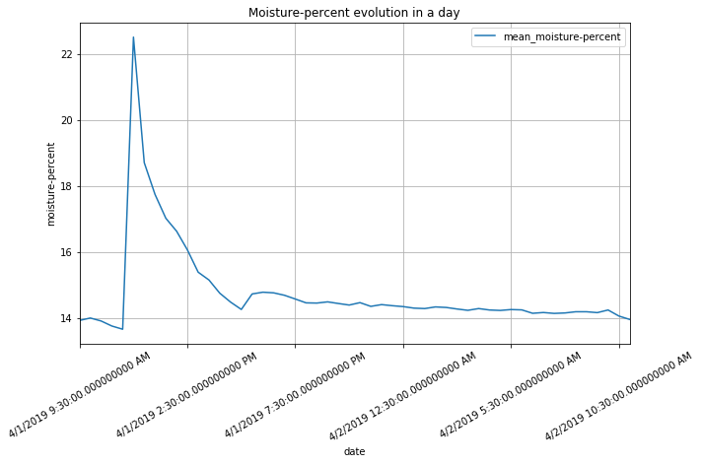
Bachelor Project - UNIGE
1
Notes:
Lumière : Lux . 10 = 10k Lux
1

Slide 11
Watering
Time since watering
What I did with my data
Reading data in dataframe
Add information on my dataframe
Implement some different strategy
Eliminate NaN value
Analyse result
1

Slide 12
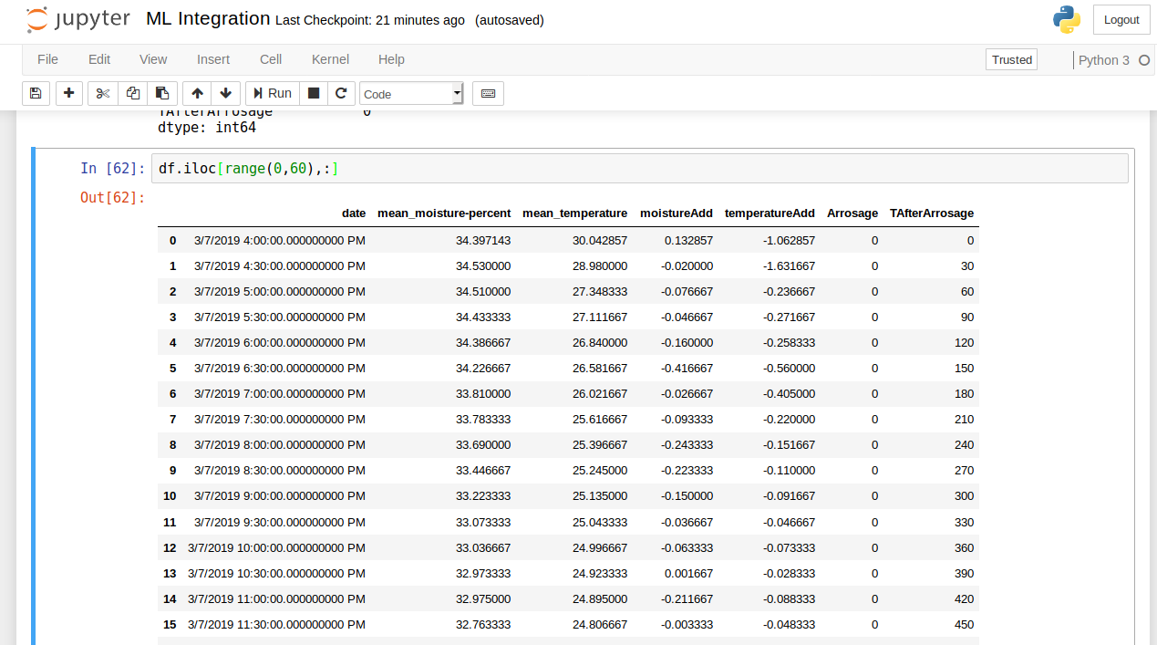
Bachelor Project - UNIGE
1

Slide 13
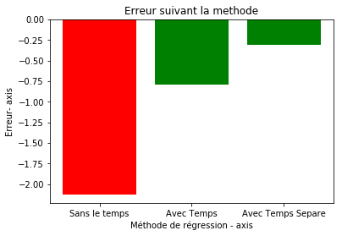
Bachelor Project - UNIGE
1

Slide 14
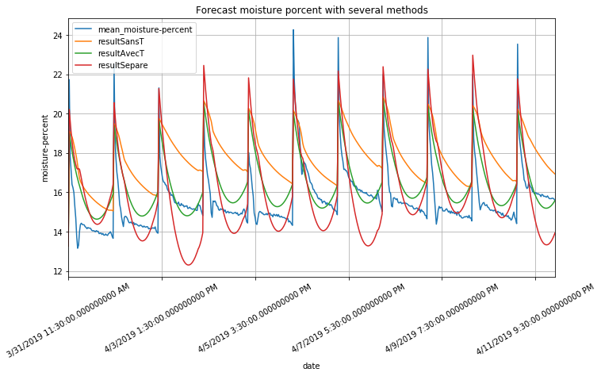

Slide 15
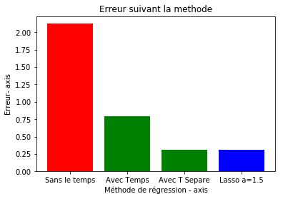
Erreur avec Lasso (a = 1.5) = 0.310217391543

Slide 16
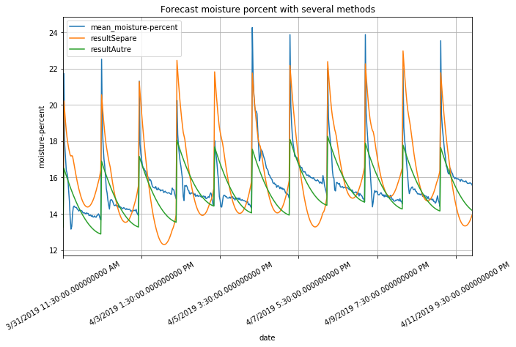

Slide 17
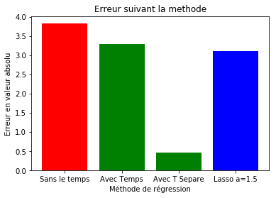

Slide 18
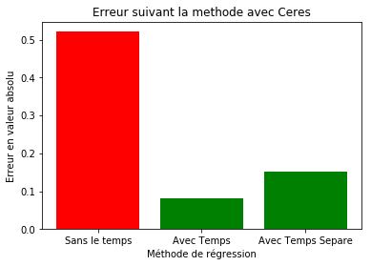
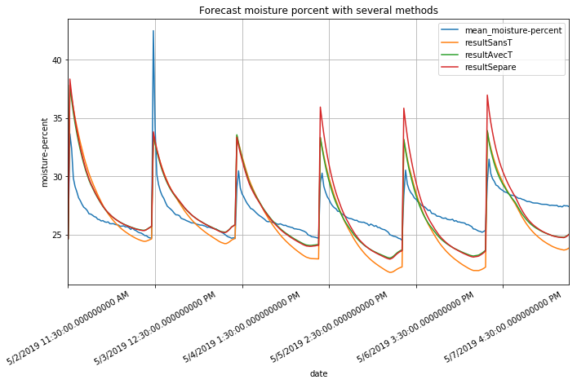

Slide 19
Date | Demeter | Ceres
6-Mar | 10 s/j | 10 s/j
13-Mar | 10 s/j | 10 s/j
20-Mar | 10 s/j | 10 s/j
27-Mar | 20 s/j | 15 s/j
3-Apr | 20 s/j | 15 s/j
10-Apr | 20 s/j | 15 s/j
17-Apr | 40 s/j | 30 s/j
24-Apr | 40 s/j | 30 s/j
1-May | 40 s/j | 30 s/j
3-May | 35s/j | 20 s/j
8-May
15-May
Watering Plan
Bachelor Project - UNIGE
1
Notes:
<numéro>

Slide 20
Planning for the next 3 weeks
To move on with my final written report
In function of the forecast
Watering forecast on some day
Analyse and chose the better algorithm
Create a watering programme
Bachelor Project - UNIGE
1
Notes:
Ou Bayesian learning machine approach for Regression
<numéro>

Slide 21
Project Planning
Bachelor Project - UNIGE
1

